Slide 1
How to Cook with C++

Slide 2
Preparation
Have you ever wanted to do something useful with C++?
Do you feel like you aren’t really using the power of you machine?
Do you like eggs?

Slide 3
What we will Need
A good grill
A good grill program
A few eggs

Slide 4
Step 1: Prepare the Grill
Best Grill Spot

Slide 5
Step 2: Write a Grill Program
What constitutes a good grill program?
Tons of Loads/Stores ? NO
Multithreading ? Yes
Vectorization ? Yes
High Flops? Yes
Ok time for Grill_v1.cpp
Notes:
CPUs overheat because of the energy loss in the switching of the transistors. This energy is dissipated in form of heat.
The more operations the CPU is running, the more transistors need to be switched with each clock cycle.

Slide 6

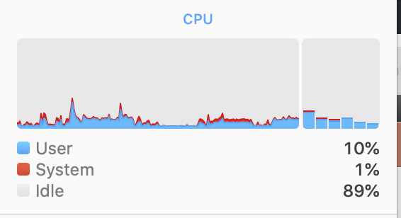
Grill_v1.cpp
int main() { while (true) { double i = 0.; i += 1.36236236236; i *= 236236.23623699102; } }
g++ -O3 grill_v1.cpp
We are not cooking with heat at all…

Slide 7
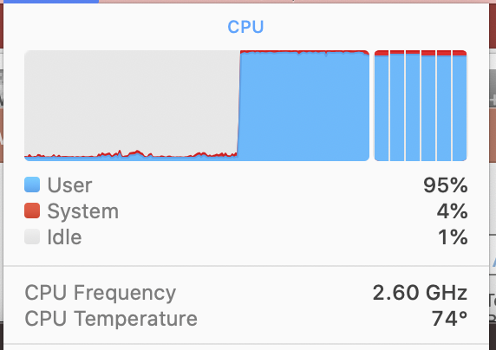
Grill_v1_parallel.cpp
int main() { while(true) { #pragma omp parallel for for (int i = 0; i < 1000; ++i) { i += 1.362362326; i *= 2336236.68236; } } }
Utilizing all CPUs
Temp is better but still low

Slide 8
This Grill Program Kinda Sucks
Temperature to cook egg ~65ºC; need higher temps to account for heat loss
It’s Not achieving max flops…
Let’s do some math…

Slide 9
My Grill
2.6 Ghz intel processor, support for AVX 256 vector operations
Max flops is 2.6 * 8 flops = 20.8 Gflops
Max total flops over 6 cores: 6 * 2.6 * 8 = 124.8 Gflops
Let’s give it a go…

Slide 10
How to Cook with Gasoline
Use intrinsics – c/c++ functions for direct assembly vector operations: AVX instruction set allows you to load 256 bit vectors or 4 doubles
We can unroll our inner loop to minimize maximize FLOPs performed inside a loop
Can perform FMA, multiplications, additions, subtractions in unrolled, vectorized manner

Slide 11
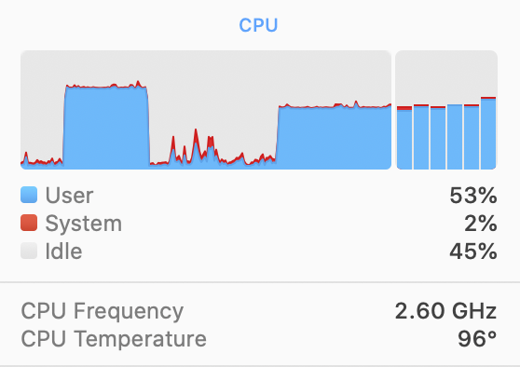
Red Hot Grill
d1
d2
d3
d4
__mm256d vector = _mm256_set1_pd(5) – Broadcast a double to a 4 double wide vector
_mm256_fmadd_pd(__mm256d v1, __mm256d v2, __mm256d v3) – Fused Multiply Add
Vector Intrinsics
_mm256_add_pd(__mm256d v1, __mm256d v2) – Vectorized Add
_mm256_mul_pd(__mm256d v1, __mm256d v2)– Vectorized Multiply
_mm256_add_pd (v1, v2);
_mm256_mul_pd (v1, v2)
_mm256_mul_pd (v1, v2)
UNROLLED
_mm256_add_pd (v1, v2);
_mm256_mul_pd (v1, v2)
….

Slide 12
Voila

